Slide 1


Campus Resource Exchange Network for Academic Resource Sharing
CSA4305 –Internet Programming
Supervisor-
Dr.D.Sudhagar
Presented by-
Deepak V-192411021
Aaron Samuel S- 19411022
Y. Abhay-192411219
Meghanadh A-1923722281
Ebin Antony P-192373011

Slide 2
ABstract
The Campus Resource Exchange Network (CREN): An Intelligent Academic Marketplace for Resource Sharing is a web-based platform designed to help students securely buy, sell, lend, donate, and exchange academic resources within the campus. The system integrates QR-based verification, trust scoring, notifications, and a centralized marketplace to ensure reliable transactions. By promoting resource reuse, the platform reduces educational expenses, minimizes waste while providing a safe academic resource-sharing environment.

Slide 3
Introduction
Enables secure exchange of campus academic resources.
Supports buying, selling, lending, donating, and swapping.
Reduces student expenses through resource reuse.
Promotes sustainable and affordable campus resource sharing.
Ensures trusted transactions using QR verification.

Slide 4
Problem statement
Students repeatedly purchase costly academic resources.
Unused materials remain wasted after every semester.
Existing platforms lack campus-specific exchange features.
Finding trustworthy student sellers is difficult.
No centralized academic resource exchange platform.

Slide 5
Objective
Develop secure campus resource exchange platform.
Simplify academic resource buying and sharing.
Reduce educational expenses through resource reuse.
Ensure trusted exchanges using QR verification.
Promote sustainability among college students.

Slide 6
Existing System
Uses general online buying and selling platforms.
Limited trust between unknown buyers and sellers.
No campus-specific verification or authentication features.
Resource searching remains inefficient and time-consuming.
Transaction security and transparency are comparatively lower.

Slide 7
Proposed system
Dedicated campus marketplace for academic resource exchange.
QR verification secures every completed transaction.
Trust scores encourage reliable student interactions.
Smart search simplifies resource discovery efficiently.
Supports buying, selling, lending, donating, and swapping.

Slide 8
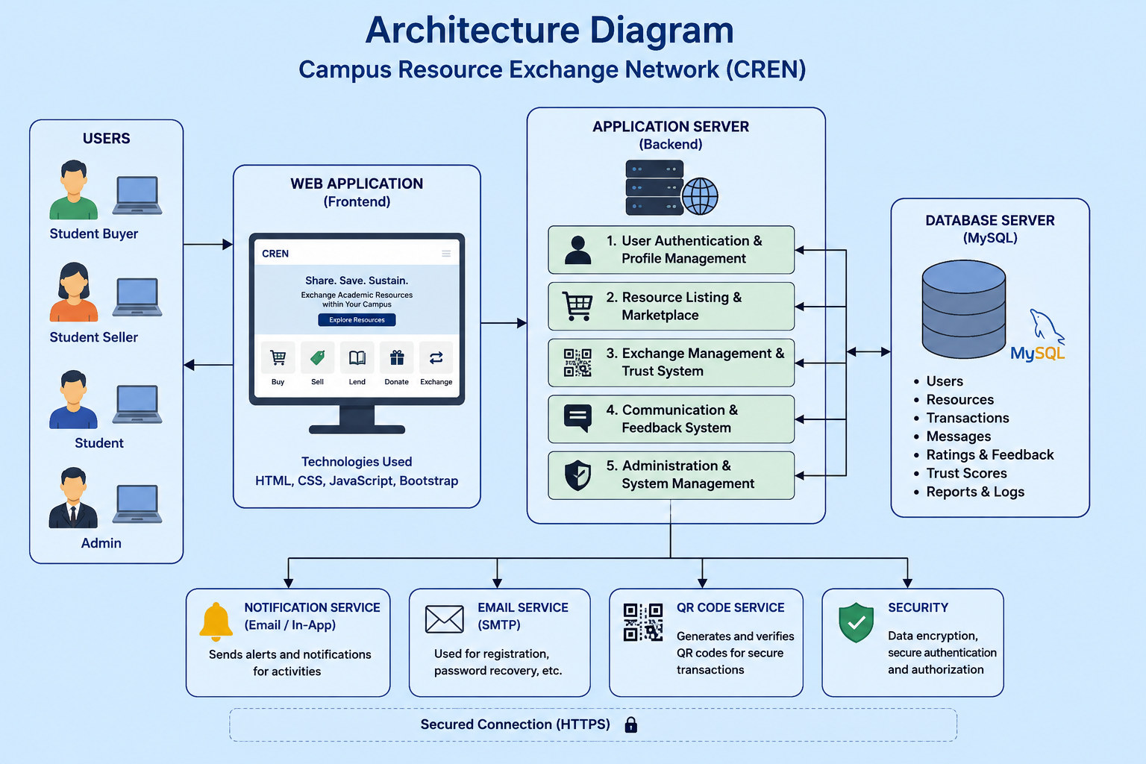

Slide 9
METhodology
MODULE 1: User Authentication & Profile Management
Register students using verified college email.
Provide secure login and password protection.
Manage student profiles and account details.
Enable password recovery through email verification.
Maintain secure user roles and permissions.

Slide 10
METhodology
MODULE 2: Resource Listing & Marketplace
Upload academic resources with complete details.
Search resources using smart filtering options.
Buy, sell, lend, donate, or exchange.
Display pricing, condition, and seller information.
Manage listings with easy editing options.

Slide 11
METhodology
MODULE 3:Exchange Management & Trust System
Generate QR codes for secure verification.
Process exchange requests between students securely.
Calculate trust scores using transaction history.
Store complete exchange and transaction records.
Collect ratings and reviews after exchanges.

Slide 12
METhodology
MODULE 4:Chat, Notifications & Feedback Management
Enable secure messaging between buyers and sellers.
Send instant notifications for exchange requests and updates.
Allow students to rate completed exchange transactions.
Collect user feedback to improve platform reliability.
Maintain communication history for future reference.

Slide 13
METhodology
MODULE 4:Chat, Notifications & Feedback Management
Enable secure messaging between buyers and sellers.
Send instant notifications for exchange requests and updates.
Allow students to rate completed exchange transactions.
Collect user feedback to improve platform reliability.
Maintain communication history for future reference.

Slide 14
METhodology
MODULE 5:Administration & System Management
Monitor users and marketplace activities efficiently.
Approve or remove inappropriate resource listings.
Handle user reports and platform complaints.
Generate reports and platform usage statistics.
Maintain overall system security and performance.

Slide 15
Tools Used
Frontend: HTML, CSS, JavaScript, Bootstrap
Backend: PHP
Database: MySQL
Server: XAMPP
QR Verification: QR Code Library
Development: Visual Studio Code
Browser: Google Chrome

Slide 16
conclusion
Provides secure campus academic resource exchange platform.
Reduces educational expenses through resource reuse.
Improves trust using QR verification mechanisms.
Encourages sustainable and collaborative student communities.
Enhances accessibility of academic resources efficiently.

Slide 17
References
[1] Hobson, K. & O’Byrne, M., “Sharing and Repairing at University,” Circular Economy and Sustainability, 2024. DOI: 10.1007/s43615-024-00403-4.
[2] Peña-García, N. et al., “Reviews, Trust, and Customer Experience in Online Marketplaces,” Frontiers in Communication, 2024. DOI: 10.3389/fcomm.2024.1460321.
[3] Jafri, M. D. M. et al., “Design and Development of a Smart Student Rental Platform,” IJRISS, 2025. DOI: 10.47772/IJRISS.2025.90900071.
[4] Jafri, M. D. M. et al., “User Acceptance Testing of a Smart Student Rental Platform,” IJRISS, 2025. DOI: 10.47772/IJRISS.2025.910000487.

